Slide 1
PREPARE
Equipping Your Kids to Confront
an Over-Sexualized Culture

Slide 2
Our Agenda
The Real World
What Parents Need to Know and Do
How You Can Protect Your Family

Slide 3
The Real World

Slide 4



Online Dangers
Real World
What apps allow access to some form of pornography?
Pokémon GO app
Delta app

Slide 5
Online Dangers
Real World
What apps allow access to some form of pornography?
Pokémon GO app
Delta app
Notes:
Make a mental note that from this point forward, you will appreciate that almost every app, regardless of its purpose, allows some hidden access to Google that does not obey the iPhone restrictions that you may have set on your child’s phone. Remember, the internet was made for access.
In the Bible app, which has click-through access to Twitter, you can find Google’s Twitter page, which has google.com as a hotlink, which you can click on, which takes you to a hidden Google search bar that does not obey the iPhone’s restrictions setting. Same for Yahoo’s Twitter page. Same for Bing’s Twitter page. Without ever leaving the Bible app ecosystem. Any app that connects internally to Twitter is a porn death-trap.

Slide 6


Online Dangers
Real World
PornHub is brilliant at marketing.
Notice the brilliant use of a recognized teen symbol to soften the acceptance.
Notes:
We must understand that the subtle ways that organizations like PornHub are normalizing the creation and consumption of pornography is sinister. This is the same organization that on Arbor Day last year had their “Gives America Wood” campaign by donating one tree for every 100 videos watched on their website. “While you’re watching some nice pieces of ash, you’ll also be helping to spruce America up!” Brilliant and wicked.

Slide 7
Barna Study
Real World
According to the 2016 Barna study, The Porn Phenomenon, what percentage of girls, ages 13-24, who periodically attend church, seek porn monthly?
13%
36%
50%

Slide 8
Barna Study
Real World
According to the 2016 Barna study, The Porn Phenomenon, what percentage of girls, ages 13-24, who periodically attend church, seek porn monthly?
13%
36%
50%

Slide 9
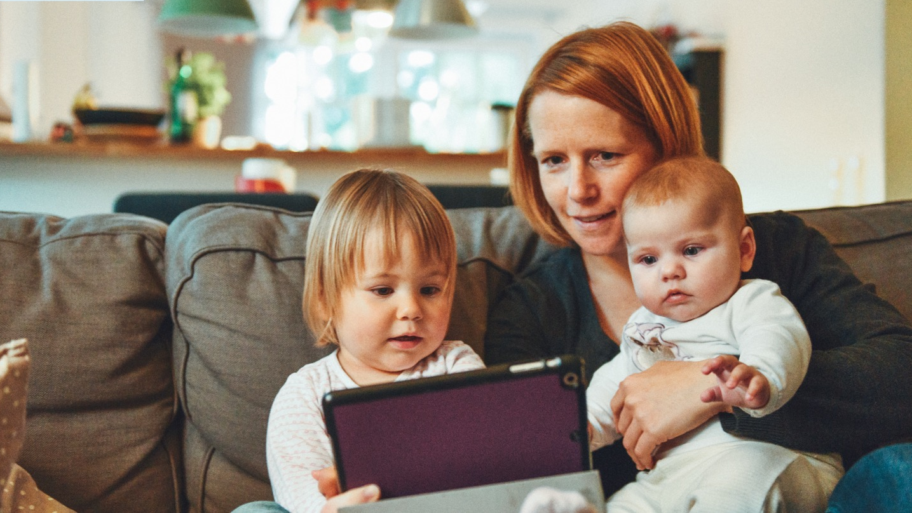

Notes:
We are living at the dawn of such a huge revolution of information, on par with the invention of written languages and the invention of the printing press. It’s no wonder, only decades into the digital media revolution, that we find it hard to get our bearings on exactly how media is positively or negatively impacting our lives.
In 1945, there were less than 10,000 TVs in the United States. That number soared to 52 million just 15 years later. Today, the average home has more TVs than it does people, and that doesn’t even count other screens.
The last 70 years have served as a massive time of transition. We have been shifting from a print-based culture to an image-based culture. It is a shift from the printed word to the digital image, from the printing press to the computer. This shift to a saturation of images affects everything: from how we do politics to how we advertise, from how we educate to how we worship.
In a print-based culture, readers process information in a text at their own pace. But in an image-based, electronic-media culture, readers must digest billions of bite-sized images—billions of pictures painting a thousand words at break-neck speeds, and it seems all we can do is react. Still living in the dawn of this new culture, it’s no wonder we haven’t yet come to terms with its full impact.
Americans watch an average of five hours of TV a day. Despite the prevalence of portable screens that have emerged in the last decade, TV viewing has hardly declined. A 2015 study from Common Sense Media indicates teens use an average of nine ours of entertainment media per day—not including screen time for school or homework—and tweens (8-12 years old) use an average of six hours per day.28
Of course, not all screen-time is created equal. Watching a mind-numbing episode of Spongebob Squarepants versus video chatting with Grandma across the country are two very different screen experiences. Being creative with media through blogging, video editing, or music creation is one thing. Passively bingeing on YouTube videos of flying cats is another. Still, the Common Sense Media study shows that among teens, only 3% of their computer, tablet, or smartphone use is spent doing content creation (like writing or creating digital art or music). Most of the time (39%) on these devices is spent in passive consumption, such as watching TV shows and movies or listening to music. The rest of the time on these devices is spent using social media or video chatting (26%), or interactive consumption like playing games or browsing the Internet (25%). Media time in the home can become like a runaway train. “Just five more minutes” can turn into 30 more. “Just one more show” turns into three more. And it's easy for parents to feel like victims to the media giant—their kids feel so drawn to it, they wonder if they can really set standards in an effective way.

Slide 10


Belief vs. Reality
Real World
Teens spend an average of 5 hours
a day online, but parents think kids spend about 2 hours a day online.
71% of kids say they hide online
activity from their parents, while 82% of parents were unaware that kids clear portions of their browser history.
Notes:
There’s obviously a gap that exists between what kids know about technology and what parents know, and sometimes, this can lead to inappropriate use of technology. Intentional parenting leverages these differences, with parents asking kids to show them how to use certain apps, being curious about what their kids are seeing on their apps, asking open questions like, “have you ever witnessed a friend make a really bad choice in Snapchat?”
Intentional parents keep the doorway constantly open, where no conversation is off-limits and not topic is shameful or weird.

Slide 11
What Parents Need
to Know and Do

Slide 12
How to Protect Kids
Parenting
1
Start talking early and often
Stay informed and educate yourself
Protect the home
Protect the devices
2
3
4

Slide 13
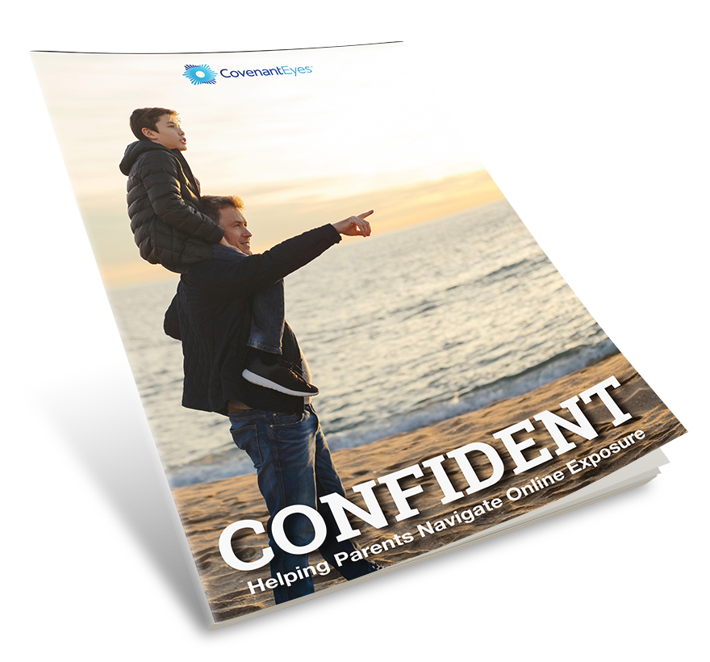
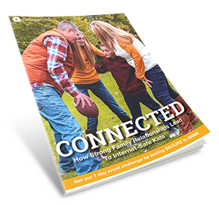
Resources
Parenting
Find these at covenanteyes.com/e-books/
Notes:
These ebooks are all available for free from Covenant Eyes.
Equipped is an overview of how porn impacts your kids, and technological and practical steps you can take to protect them.
Confident helps you address your child’s porn use if you learn they have already viewed it.
Connected explores the importance of strong parent/child relationships and how they reduce porn temptations in the first place.

Slide 14

Talk Early and Often
Parenting
Tone is everything
Don’t do all the talking
Listen, really listen
Do some discovery
Age appropriate conversations

Slide 15

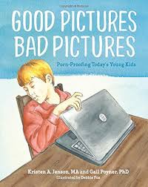
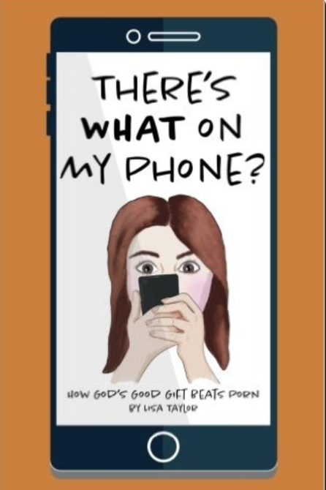
Talk Early and Often
Parenting
Find these at protectyoungeyes.com/resources

Slide 16

Conversation Tips: Ages 2-6
Parenting
This age is very literal
Limit what they consume
Find out what they know
Keep it simple
Use proper names for body parts
The bathing suit area is private
Source: Common Sense Media

Slide 17

Conversation Tips: Ages 7-12
Parenting
Create a safe environment to talk about anything
Find out what they know
Address their curiosity
Be sensitive to their emotions
Encourage critical thinking
Look for positives
Source: Common Sense Media
Notes:
Some kids on the bottom end of this range still may have difficulty with what’s real and pretend. Older ones are developing abstract-thinking skills, real-world experience, and the ability to express themselves. They’re about to enter puberty and start acting more independently. They may see pornography, violent video games, mass shootings, and bullying. They need to be able to talk with you without feeling shame or embarrassment.

Slide 18

Conversation Tips: Teens
Parenting
Challenge them to consider complexities
Share your values
Ask what they would do
Encourage open dialogue
Ask open ended questions
Admit when you just don’t know
Source: Common Sense Media
Notes:
They’re interacting with media independently by reading it, creating their own, and sharing online. They often hear about difficult subjects through the news media, video games, chats, and social media without your knowledge.

Slide 19
“…for at one time you were darkness, but now you are light in the Lord. Walk as children of light (for the fruit of light is found in all that is good and right and true), and try to discern what is pleasing to the Lord. Take no part in the unfruitful works of darkness, but instead expose them. For it is shameful even to speak of the things that they do in secret. But when anything is exposed by the light, it becomes visible, for anything that becomes visible is light. Therefore it says, ‘Awake, O sleeper, and arise from the dead, and Christ will shine on you.’”
Ephesians 5:8-14

Slide 20
How to Protect Kids
Parenting
1
Start talking early and often
Stay informed and educate yourself
Protect the home
Protect the devices
2
3
4

Slide 21


Stay Informed
Parenting
Check out these websites to sign up for their blog or newsletter

Slide 22
How to Protect Kids
Parenting
1
Start talking early and often
Stay informed and educate yourself
Protect the home
Protect the devices
2
3
4

Slide 23


Protect the Home
Parenting
CleanBrowsing and OpenDNS are free and can be used on most routers to filter certain content.
Some routers come with a parental control dashboard. Use it!

Slide 24
How to Protect Kids
Parenting
1
Start talking early and often
Stay informed and educate yourself
Protect the home
Protect the devices
2
3
4

Slide 25
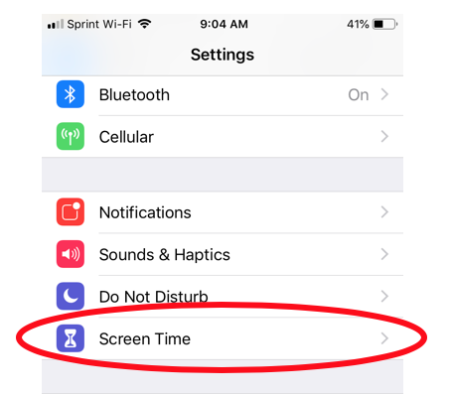
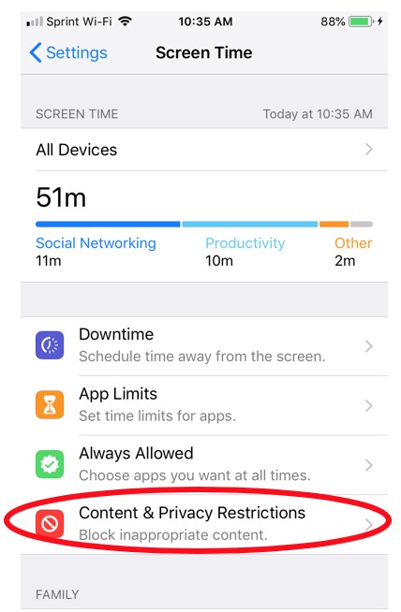
Protect the Devices
Parenting
Every family with Apple devices should know about Screen Time and Family Sharing. Text HOME to 66866 to get a free email series with more info.

Slide 26

Protect the Devices
Parenting
Covenant Eyes Screen Accountability™ and Filtering is available on most computers, smartphones, and tablets.

Slide 27
Loving Guardrails are Necessary
Parenting
“No discipline seems pleasant at the time, but painful.
Later on, however, it produces a harvest of righteousness
and peace for those who have been trained by it.”
Hebrews 12:11

Slide 28
Questions?

